Slide 1




Emerging Graph Queries in Linked Data
Arijit Khan, Yinghui Wu, Xifeng Yan
Department of Computer Science
University of California, Santa Barbara
{arijitkhan, yinghui, xyan}@cs.ucsb.edu

Slide 2
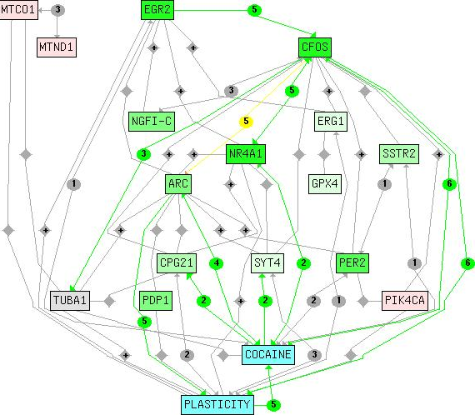
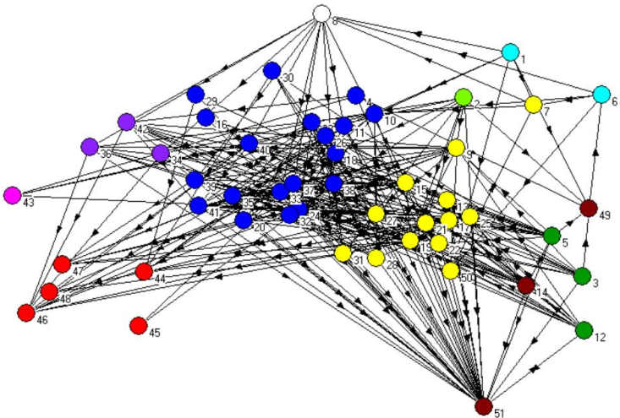
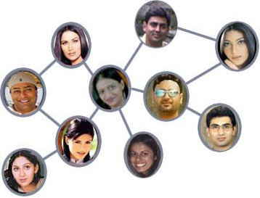
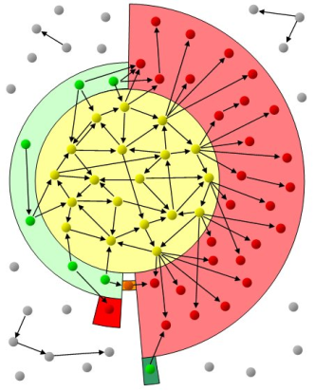
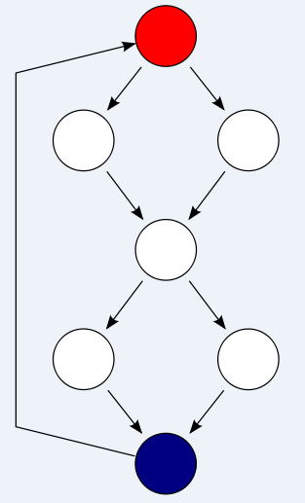
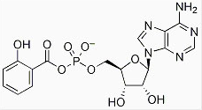

Graph Data
Graphs are everywhere.
Biological Network
Ecological Network
Social Network
Chemical Network
Program Flow
Web Graph
2
Notes:
INSTRUCTIONS: Standard technical results slide (2-slide version). Please keep this layout and subheadings. A template is at the end of this exemplar.
Bar-Noy, Basu, Johnson, Ramanathan, “Minimum-cost Broadcast through Varying-size Neighborcast”, Algosensors 2011, Germany, Sept 2011
Johnson, Phelan, Bar-Noy, Basu, Ramanathan, “Minimum-cost Broadcast through Varying-size Neighborcast”, Draft for submission to IEEE ToN (ToN paper has some more hardness results, simulation study and comparisons)
The problem of interest is to broadcast a message originating at a source node to all nodes in the network.
Source node and relay node can multicast to a subset of their neighbors (and they may also perform multiple multicasts to disjoint sets of neighbors). If a node multicasts to a subset k of its neighbors, the incurred cost is 1 + A k^b, where A, b are non-negative constants; `1’ represents the normalized cost of the (first) transmission, and the second term the cost of ACKs and re-transmits. The work also considers the case where the second term is either a sub-linear or a super-linear function of k. The minimum cost problem is formulated as an integer programming problem, and is NP-hard for a range of b expressed as a function of A.
The top line in the table is, in fact, a very important result: if b > g(A) := log₂( 2 + 1/A), then multicast cannot outperform unicast; thus, the spanning tree is optimal.
If b=0, problem reduces to the connected dominating set (CDS) problem for which approximability results are known; the approximation ratio is H_{Δ}+ 2
If b=1, problem reduces to minimizing number of transmitters (equivalently the maximum leaf spanning tree); a polynomial time algorithm with approximation ratio 2 is known; the paper improves the approximation ratio by using a pruned CDS approach.
For b > g(A), spanning tree is optimal
For b < g(A), the problem is shown to be NP-hard
For 1 < b < g(A), the paper shows that a spanning tree has very good approximation ratio (less than 2)
For 0 < b < 1, a greedy algorithm is proposed and its approximation ratio derived. Note that the approximation ratio improves with larger b and smaller Δ
Overall note that the approximation ratio becomes worse for smaller b
Note: the network size ‘n’ plays a part in the `inapproximability’ results
The model assumes a known cost function; but the exponent ‘b’ depends both upon the actual protocol as well as open the operating environment (e.g., congestion). Thus ‘b’ may vary and may be hard to estimate. How sensitive is the proposed algorithm when there are errors in estimating ‘b’? The figure on the right shows cost (as incurred by the proposed algorithm) vs. the actual ‘b’ of the underlying cost function; the black curve is the `optimal’ one – it uses the true value of ‘b’; the performance of the algorithm when ‘b’ is assumed to be fixed at some value is shown
Here, Δ is the maximum node degree in the graph
H_{n} = n-th Harmonic number = 1 + 1/2 + 1/3 + ¼ + … + 1/n ~= log (n) + \gamma + small constant
Where \gamma is the Euler-Mascheroni constant, approximately 0.5772

Slide 3
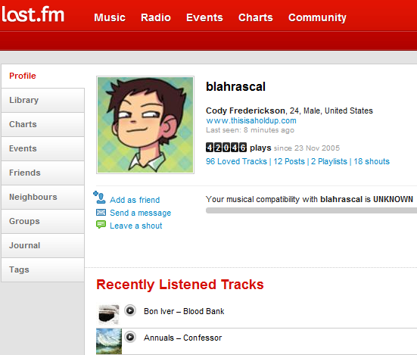
Complex Graphs
Real-life graph contains complex contents – labels associated with nodes, edges and graphs.
Node Labels:
Location, Gender, Charts, Library, Events, Groups, Journal, Tags, Age, Tracks.
3
Notes:
INSTRUCTIONS: Standard technical results slide (2-slide version). Please keep this layout and subheadings. A template is at the end of this exemplar.
Bar-Noy, Basu, Johnson, Ramanathan, “Minimum-cost Broadcast through Varying-size Neighborcast”, Algosensors 2011, Germany, Sept 2011
Johnson, Phelan, Bar-Noy, Basu, Ramanathan, “Minimum-cost Broadcast through Varying-size Neighborcast”, Draft for submission to IEEE ToN (ToN paper has some more hardness results, simulation study and comparisons)
The problem of interest is to broadcast a message originating at a source node to all nodes in the network.
Source node and relay node can multicast to a subset of their neighbors (and they may also perform multiple multicasts to disjoint sets of neighbors). If a node multicasts to a subset k of its neighbors, the incurred cost is 1 + A k^b, where A, b are non-negative constants; `1’ represents the normalized cost of the (first) transmission, and the second term the cost of ACKs and re-transmits. The work also considers the case where the second term is either a sub-linear or a super-linear function of k. The minimum cost problem is formulated as an integer programming problem, and is NP-hard for a range of b expressed as a function of A.
The top line in the table is, in fact, a very important result: if b > g(A) := log₂( 2 + 1/A), then multicast cannot outperform unicast; thus, the spanning tree is optimal.
If b=0, problem reduces to the connected dominating set (CDS) problem for which approximability results are known; the approximation ratio is H_{Δ}+ 2
If b=1, problem reduces to minimizing number of transmitters (equivalently the maximum leaf spanning tree); a polynomial time algorithm with approximation ratio 2 is known; the paper improves the approximation ratio by using a pruned CDS approach.
For b > g(A), spanning tree is optimal
For b < g(A), the problem is shown to be NP-hard
For 1 < b < g(A), the paper shows that a spanning tree has very good approximation ratio (less than 2)
For 0 < b < 1, a greedy algorithm is proposed and its approximation ratio derived. Note that the approximation ratio improves with larger b and smaller Δ
Overall note that the approximation ratio becomes worse for smaller b
Note: the network size ‘n’ plays a part in the `inapproximability’ results
The model assumes a known cost function; but the exponent ‘b’ depends both upon the actual protocol as well as open the operating environment (e.g., congestion). Thus ‘b’ may vary and may be hard to estimate. How sensitive is the proposed algorithm when there are errors in estimating ‘b’? The figure on the right shows cost (as incurred by the proposed algorithm) vs. the actual ‘b’ of the underlying cost function; the black curve is the `optimal’ one – it uses the true value of ‘b’; the performance of the algorithm when ‘b’ is assumed to be fixed at some value is shown
Here, Δ is the maximum node degree in the graph
H_{n} = n-th Harmonic number = 1 + 1/2 + 1/3 + ¼ + … + 1/n ~= log (n) + \gamma + small constant
Where \gamma is the Euler-Mascheroni constant, approximately 0.5772

Slide 4
Large Graphs
Large Scale Graphs.
 | # of Users | # of Links
Facebook | 400 Million | 52K Million
Twitter | 105 Million | 10K Million
LinkedIn | 60 Million | 0.9K Million
Last.FM | 40 Million | 2K Million
LiveJournal | 25 Million | 2K Million
del.icio.us | 5.3 Million | 0.7K Million
DBLP | 0.7 Million | 8 Million

Slide 5
No Fixed Schema
Lack of fixed schema, label and type information.
Darren E. Burrows
Burrows, Darren E.
Cry-Baby
Amistad
James
Waters
(I)
Steven
Spielberg
Waters,
James
Spielberg,
Steven
IMDB Network
FreeBase Movie Dataset

Slide 6
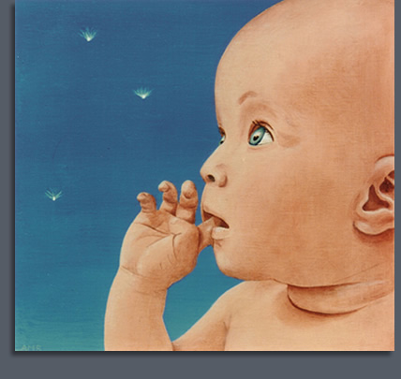
Challenges
Novel graph queries are emerging, that integrate both structure and content information.
Traditional graph algorithms do not scale well for large scale graphs.
Standard SQL or SPARQL queries cannot be applied due to lack of fixed schema, label and type information.

Slide 7

Related Work
Traditional Graph Queries:
Shortest Path
Reachability
Subgraph Isomorphism
Page Rank
Influence Maximization
Graph Clustering
Emerging Graph Queries:
Keyword Search
Graph Search
Graph Pattern Matching
Graph Pattern Mining
Anomaly Detection
Graph Skyline
Graph OLAP
Ranking and Expert Finding
Graph Aggregation

Slide 8
Presentation Sketch
KEYWORD SEARCH
GRAPH SEARCH
GRAPH PATTERN MATCHING
GRAPH PATTERN MINING
CONCLUSION

Slide 9
Keyword Search Queries
Query: a set of keywords.
Input Data:
Text Documents
XML
Relational Database
Graph
Inverted Index: (Salton et. al., A vector space model for information retrieval. Communications of the ACM, ’75)
Probabilistic Relevance Model: (Maron et. al., On relevance, probabilistic indexing and information retrieval. Journal of the ACM, ‘60)
Inference Model: (Turtle et. al., Inference Networks for Document Retrieval, COINS Tech. report, ‘92)

Slide 10
Keyword Search Queries
Query: a set of keywords.
Input Data:
Text Documents
XML
Relational Database
Graph
Does not work in structured and semi-structured data.
Keyword search over structured and semi-structured data needs to assemble data from various locations, that are inter-connected and collectively relevant to the query.

Slide 11
Keyword Search Queries
Why Keyword Search over Structured and Semi-structured data?
Relieve casual users from the difficulties of learning exact schema and structured query language.
The exact schema might be unknown or dynamic in nature.
Access heterogeneous data.
Reveal interesting or unexpected relations among entities.
Community in social network.
Query: a set of keywords.
Input Data:
Text Documents
XML
Relational Database
Graph

Slide 12
Keyword Search Queries
Query: a set of keywords.
Input Data:
Text Documents
XML
Relational Database
Graph
XML has Tree structure.
Result is a sub-tree rooted at the lowest common ancestor (LCA) of a set of nodes that collectively match query keywords.
Threshold Algorithm based approach [XRANK, Guo et. al., SIGMOD ‘03]

Slide 13
XRANK Guo et. al., SIGMOD ‘03
Query Keywords = {a. b}
Find Top-1 Result
u₁
u₂
u₃
u₄
a
u₅
u₆
u₇
Threshold Algorithm in XRANK
b
a
b
a | b
u₂ → 1 | u₅ → 1
u₆ → 1 | u₇ → 1
u₁ → 2 | u₂ → 2
u₃ → 2 | u₃ → 2
 | u₁ → 3
u₂ → 3
u₅ → ∞
u₆→ ∞
u₇ → ∞
u₁ → 5
u₈
u₉
u₁₀
2
XML Documents
2
4
Index
Top-1 Buffer

Slide 14
Keyword Search Queries
Query: a set of keywords.
Input Data:
Text Documents
XML
Relational
Database
Graph
XSEarch, Cohen et. al., VLDB ‘03.
Li et. al., VLDB ’04
Theobald et. al., VLDB ‘05
Xu et. al., SIGMOD ’05, EDBT ‘08
Sun et. al., WWW ’07
Chen et. al., ICDE ‘10
Keyword Search in Probabilistic XML, Li et. al., ICDE ‘11.

Slide 15
Keyword Search Queries
The database is modeled as a directed graph.
Tuples → nodes.
Foreign-key, Primary-key link → edge.
Result is a rooted directed tree (total and minimal) containing at least one node having each query keyword.
DISCOVER [Hristidis et. al., VLDB ‘02]
BANKS [Aditya et. al., VLDB ‘02]
DBXplorer [Agrawal et. al., ICDE ‘02]
S-KWS [Markowetz et. al., SIGMOD ‘07]
KRDBMS [Qin et. al., SIGMOD ‘09]
Kdynamic [Qin et. al., ICDE ’09]
Query: a set of keywords.
Input Data:
Text Documents
XML
Relational
Database
Graph

Slide 16
Keyword Search Queries
Ranking of the result trees.
DISCOVER II [Hristidis et. al., VLDB ‘03]
Assigns each tuple in result tree an individual score (similar to text document ranking).
Combine the scores of all tuples in the result tree.
SPARK [Lou et. al., ICDM ‘07]
- Consider the whole result tree as a single virtual document.
- Find the score (similar to text document ranking).
Query: a set of keywords.
Input Data:
Text Documents
XML
Relational
Database
Graph

Slide 17
Keyword Search Queries
Query: a set of keywords.
Input Data:
Text Documents
XML
Relational
Database
Graph
Tree Based Approach:
- Result is a connected tree containing all query keywords.
- Score: (i) sum of all edge weights in the tree. or, (ii) sum of all path weights from root to each keyword in the tree.
- Find top-k result trees with minimum score.
Bidirectional Search [Kacholia et. al., VLDB ‘05]
BLINKS [He et. al., SIGMOD ‘07]
Dynamic Programming [Ding et. al., ICDE ’07]
External Memory [Dalvi et. al, VLDB ‘08]

Slide 18
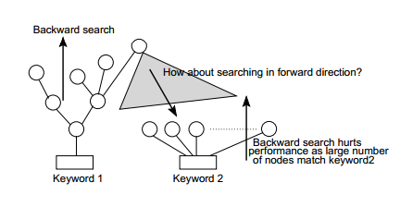
Bidirectional Search Kacholia et. al., VLDB ‘05
Backward Search: All the single source shortest path iterators from query keywords merged into a single iterator, called the incoming iterator.
Forward Search: An outgoing iterator runs concurrently, which follows forwarding edges starting from all the nodes explored by the incoming iterator.
Prioritize: Spreading activation to prioritize the search, which chooses incoming iterator or outgoing iterator to be called next.
Requirement for Bidirectional Search
18

Slide 19
Keyword Search Queries
Query: a set of keywords.
Input Data:
Text Documents
XML
Relational
Database
Graph
Graph Based Approach:
- Result is a connected graph containing all query keywords.
- Score: (i) sum of all edge weights in the graph. or, (ii) maximum pairwise distance. or, (iii) min-max pairwise distance.
- Find top-k result graphs with minimum score.
EASE [Li et. al., SIGMOD ‘08]
r-Clique [Kargar et. al., KDD ‘11]
Team Formation [Lappas et. al., KDD ‘09]

Slide 20
Limitations of Keyword Search
Structure is implicit in the keyword search queries. What if we have a more structured query?
Find a movie of actress ‘Kate Winslet’, that is directed by the same director who also worked with actor ‘Stephen Lang’.
Label: Kate Winslet
Type: Actor
Label: ?
Type: Movie
Label: ?
Type: Director
Label: Stephen Lang
Type: Actor
Query Graph

Slide 21
Presentation Sketch
KEYWORD SEARCH
GRAPH SEARCH
GRAPH PATTERN MATCHING
GRAPH PATTERN MINING
CONCLUSION

Slide 22
Application of Graph Search
Identify objects and scenes from images.
Verify the existence of a chemical compound in a medicine.
RDF Query Answering.
Entity Name Disambiguation.
Alignment of Networks.

Slide 23
Graph Search Queries
Retrieves all graphs from a graph database, such that they contain a given query graph (exact and approximate).
Containment Query
Similarity Query
Matching Query
Q
G₁
G₂

Slide 24
Graph Search Queries
Retrieves all graphs from a graph database, that are similar to the query graph (exact and approximate).
Containment Query
Similarity Query
Matching Query
Q
G₁
G₂

Slide 25
Graph Search Queries
Find all occurrences of a query graph in a large target network (exact and approximate).
Containment Query
Similarity Query
Matching Query
Q
G

Slide 26
Containment Query
Subgraph Isomorphism Problem is NP-hard.
Filtering and Verification
Filtering Phase:
Feature-based index is used to filter out the negative results and generate a candidate sets.
Verification Phase:
Precise Subgraph Isomorphism Testing to generate final results from the candidate set.
Q
G₁
G₂
G₁
---
Q
Containment Query
G₁
G₂
Q
G₁
G₂
---
G₁
---
Q
G₁
G₂
---
Edge Based Index
Filtering

Slide 27
Containment Query (Related Work)
What Feature Based Index to select for Filtering Phase?
gIndex (Frequent Subgraph). Yan et al, SIGMOD ’04
FG-Index (Frequent Subgraph) Cheng et. al, SIGMOD ’07
TreePi (Frequent Tree) Zhang et. al, ICDE ’07
Tree+Delta (Frequent Tree) Zhao et. al, VLDB ‘07
GraphGrep (Path). Shasha et al, PODS ’03
Daylight FP (Path) James et. al, Daylight Th. Manual ’05
GraphGrepSX (Path) Bonnici et. al, PIRB ’10
SING (Path+Locality) Natale et. al, BMC Bioinformatics ’10
CT-index (Tree) Klein et. al. ICDE ’11
GDIndex (Graph) Williams et. al. ICDE ‘07
Frequent Pattern Mining Approach.
Exhaustive Enumeration Based Approach.
Precise Subgraph Isomorphism Test in Verification Phase.
Detailed Comparison and Evaluation in iGraph, Han et. al., PVLDB ‘10
Ullamnn’s Backtracking Algorithm. J. ACM ’76
VF2, Cordella et. Al., IEEE Tran. On Pattern Analysis and Machine Intelligence ‘04.
SwiftIndex. Shang et. Al., VLDB ’08.

Slide 28
Containment Query (Related Work)
Indexing without Features in Filtering Phase.
C-Tree (Closure Tree), He et. al. ICDE ’06
GC-Coding (Spectral encoding of neighborhood), Zou et. al., EDBT ‘08.
Approximate Containment Query.
Grafil, Yan et. al. SIGMOD ’05
Grafil+, Shang et. al., SIGMOD ‘10.

Slide 29
Similarity Query
Graph Isomorphism is neither known to be Polynomial or NP-Complete.
Graph Edit Distance NP-hard.
Q
Maximum Common Subgraph (MCS) based approach.
Δ = |d( Q, MCS(Q,G) )| + |d(G, MCS(Q,G))|
MCS is NP-hard.
Efficiently Finding MCS of two large networks (Approximate) - Zhu et al., CIKM ’11
Indexing based on MCS in Filtering Phase – Zhu et. al., EDBT ‘12
Maximum Common Subgraph (MCS) based approach.
| d( Q, MCS(Q,G₁) ) | = 2
| d(G₁, MCS(Q,G₁)) | = 2
Δ = |d( Q, MCS(Q,G₁) )| + |d(G₁, MCS(Q,G₁))| = 4
G₁
| d( Q, MCS(Q,G₂) ) | = 0
| d(G₂, MCS(Q,G₂)) | = 10
Δ = |d( Q, MCS(Q,G₁) )| + |d(G₁, MCS(Q,G₁))| = 10
G₂

Slide 30
Similarity Query
Kernel Based Approach.
Measure similarity of two graphs by comparing their substructures.
Map two graphs G₁ and G₂ via mapping φ into feature space H.
a
r
φ ≡ length of all walks between every ordered pair of. Labels.
e.g., φ_{(c , a)} = φ_{(a , r)} = φ_{(r , t)} = 1
φ_{(a , t)} = 1+2 = 3
φ_{(c , t)} = 2+3 = 5
φ_{(c , c)} = 0 etc.
c
t
Measure their similarity in H as scalar product <φ(G₁), φ(G₂)> .
Kernel Trick: Compute inner product in H as kernel in input space k(G₁, G₂) = <φ(G₁), φ(G₂)> ; e.g., compute walks in the product graph G₁×G₂ .
- Positive Definite.

Slide 31

Similarity Query
Complete Graph Kernel: Let k(G₁, G₂) = <φ(G₁),φ(G₂)> be a graph kernel. If φ is injective, k is called a complete graph kernel.
Example: The graph kernel that has one feature Φ_{H} for each possible graph H, each feature Φ_{H}(G) measuring how many subgraphs of G have the same structure as graph H.
The above example of Complete Graph Kernel is NP-hard.
Theorem: Computing any complete graph kernel is at least as hard as deciding whether two graphs are isomorphic [Gärtner et. al., COLT ‘03]

Slide 32
Graph Kernels
Polynomial Time Computable Graph Kernels:
Random Walk - Kashima et al., ICML ’03
- Gaertner et al., COLT ’03
- Mahe et al., ICML ’04
- Vishwanathan et al., NIPS ‘06
Shortest Path - Borgwardt et. al., ICDM ‘05
Optimal assignment kernel - Froehlich et al, ICML ‘05
[NOT Positive definite, Vert, ‘08]
Weighted Decomposition Kernel - Menchetti et al., ICML ’05
Edit-Distance Kernel - Neuhaus et. al., SSPR/SPR ‘06
Subtree Kernel - Ramon et. al., Mining Graphs, Trees and Sequences ’04
- Shervashidze et. al., NIPS ’09
Cyclic Pattern Kernel - Horvath et al., KDD ’04
Neighborhood Kernel - Wang et. al., EDBT ’09

Slide 33
Graph Matching Query
Graph Matching Query
Biological Network
Social/ Information Network
Q
PathBLAST
G-Ray
SAGA
TALE
NetAlign
SIGMA
ISORANK
COSI
G
GRAAL
33
NeMa
NESS

Slide 34
SAGA [Tian et. al., Bioinformatics ‘06]
Approximate Subgraph Matching considering both structural and node label difference.
Index Based Matching Algorithm:
Measure similarity of two graphs by comparing their substructures.
Build an index on small graph substructures in the database.
Use the index to match fragments of the query with fragments in database, allowing for various types of mismatches.
Combine compatible matched fragments to constructed larger matches using maximal graph clique detection algorithm.
The best match is identified by verifying all these larger matches.
Gap Node
Difference in Node Labels
Target Graph
Query Graph

Slide 35
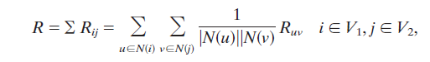
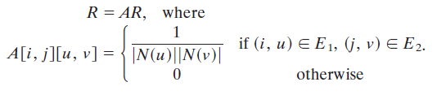
ISORANK [Singh et. al., PNAS ‘08]
Alignment of biological networks, that supports mismatch in node labels and graph structure.
Eigen Value Method:
Converts the graph matching problem into an Eigen Value problem.

Slide 36
G-Ray [Tong et. al., KDD ’07]
Approximate Subgraph Matching that preserves the shape of the query.
G-Ray Technique:
Seed-Finder : It selects a desired attribute-value node from the query graph and ﬁnds a “very promising” matching data node with that attribute value.
Neighbor-Expander: It expands the seed node, by ﬁnding a “good” matching node with the desired attribute value according to query graph.
Bridge: It ﬁnds a “good” path to connect two matching data nodes if they are required to be connected according to query graph.
Shape Preserving Approx. Query Matching

Slide 37
TALE [Tian et. al., ICDE ’08]
Top-k approximate subgraph matches based on the number of missing edges.
Neighborhood (NH) Index:
Build an index structure based on the neighborhood of each node in the data graph.
Use this neighborhood index structure to match query graph nodes and rank them based on the quality of matches.
Successively find high-ranked adjacent nodes from the matched lists and add them in the final result graph.
Rank (1)
Rank (2)

Slide 38
SIGMA [Mongiovi et. al., J. Bio.and Comp. Biology ’10]
Find all subgraph matches that allows up to r edge deletions.
Set Cover Based Method:
Index the data graph and query graph using local features.
Identify the features present in the query graph but missing from the data graph.
Is it possible to cover all the missing features by using a maximum of r edges from the query graph?

Slide 39
Motivation (NESS) [Khan et. al., SIGMOD ‘11]
Which actors have appeared in both a “John Waters” movie and a “Steven Spielberg” movie?
SELECT ?actorName WHERE {
?actor <actor/actor_Name> ?actorName.
?director1 <director/director_name> “S. Spielberg”.
?director1Movie <movie/actor> ?actor;
<movie/director> ?director1.
?director2 <director/director_name> “J. Waters”.
?director2Movie <movie/actor> ?actor;
<movie/director> ?director2.
}
Name
Name
Actor
Director
Writing of a SPARQL query requires to know how the entities are connected in the graph data.
act
direct
Movie
Title
ER Diagram
SPARQL Query

Slide 40
RDF Query Answering
?
Name
Name
Actor
Director
J. Waters
S. Spielberg
Query Graph
act
direct
How the entities are connected is less important than how closely they are connected.
Darren E. Burrows
Movie
Title
Cry-Baby
Amistad
ER Diagram
J. Waters
S. Spielberg
Matching Subgraph

Slide 41
Existing Graph Similarity Measures Does Not Work …
f₁
# Missing Edges: 1 (both for f₁ and f₂).
Graph Edit Distance: 2 (for f₁), 1 (for f₂).
Graph Edit distance, # of Missing Edges are not scalable for large graphs.
a
c
b
a
b
c
f₂
Q
a
b
c
Embeddings in G
Difficulties with the # of Edge Mismatch or Graph Edit Distance
f₁ is a better match than f₂ considering the proximity of the labels.

Slide 42
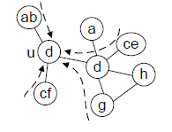
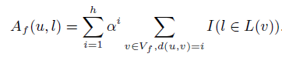
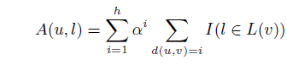
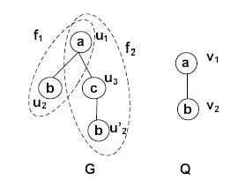
Information Propagation Model
Convert the label distribution in the neighborhood of each node u into a multi-dimensional vector R(u)={<u, A(u,l)>}.
Information Propagation Model
h = 2, α = 0.5
R_{Q}(v₁)= {<b, 0.5>} , R_{Q}(v₂)={<a, 0.5>}
R_{f1}(u₁)= {<b, 0.5>}, R_{f1}(u₂)= {<a, 0.5>}
R_{f2}(u₁)= {<b, 0.25>}, R_{f2}(u’₂)= {<a, 0.25>}
Example of Neighborhood Vectorization

Slide 43
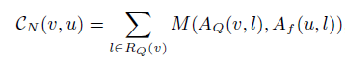
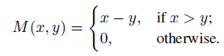
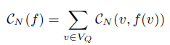
Problem Definition
Neighborhood Based Cost Function:
- Positive difference between the
neighborhood vectors.
Neighborhood Based Cost Function
h = 2, α = 0.5
R_{Q}(v₁)= {<b, 0.5>} , R_{Q}(v₂)={<a, 0.5>}
R_{f1}(u₁)= {<b, 0.5>}, R_{f1}(u₂)= {<a, 0.5>}
R_{f2}(u₁)= {<b, 0.25>},
R_{f2}(u’₂)= {<a, 0.25>}
C_{N}(f₁) = 0
C_{N}(f₂) = (0.5-0.25)+(0.5-0.25)=0.5
Neighborhood Based Top-k Similarity Search: Given a target graph G and a query graph Q, find the top-k embeddings with respect to cost C_{N}.

Slide 44
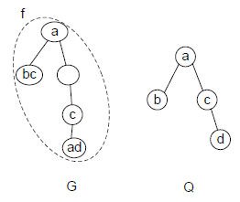
Cost Function Properties
For an exact embedding f_{e}, C_{N}(f_{e} )=0.
Neighborhood Based Cost Function can have False Positives.
False Positive, C_{N}(f )=0, for h=1.
Given a graph G and a query graph Q, if each of their nodes has a distinct label, for any inexact embedding f, C_{N}(f )>0, for all h>0, α > 0.

Slide 45
Cost Function Properties
Neighborhood Based Top-k Similarity Search is NP-hard.
Given two graphs Q and G of same number of nodes, it can be determined in polynomial time if G itself is an embedding f of Q with C_{N}(f )=0.

Slide 46
Search Algorithm
Step 1: Match a node u of target graph G with some node v of query graph Q, if L(v) ⊆ L(u) and cost(u,v) is less than a predefined cost threshold ε.
Step 2: Discard the labels of the unmatched nodes in the target graph.
Step 3: Propagate the labels only among the matched nodes from the previous step. Repeat steps 1 and 2 until no node can be discarded further.
u₁
u₂
v₁
u₃
v₂
v₃
u₄
u₅
v₄
u₆
G
Q
Search Algorithm
h=1, α=0.5, ε=0

Slide 47
Experimental Results
WebGraph with 10M nodes and 213M edges can be queried
in 0.11 sec.

Slide 48
Limitations of NESS
How to perform Graph Similarity Search when the node labels may also vary?
Find the manufacturer of bicycle type ‘Road Bicycle’ and bicycle model ‘Avanti Quantum’.
Label: ?
Label: Avanti
Label: Avanti
Quantum
Label: Road
Bicycle
Label: Avanti
Quantum 1.0
Label: Road
Bicycle
Query Graph
Top-1 Result
(Freebase Bicycle Dataset)

Slide 49
Presentation Sketch
KEYWORD SEARCH
GRAPH SEARCH
GRAPH PATTERN MATCHING
GRAPH PATTERN MINING
CONCLUSION

Slide 50
Homomorphism and Simulation for Graph Pattern Matching
Traditional homomorphism and simulation based graph matching is not capable for capturing real life graph similarity and matches
(1-1) P-homomorphism, edge to path matching, provable guarantees on match quality (VLDB 2010).
Bounded simulation, bounded connectivity, PTIME (VLDB 2010).
Incremental bounded simulation, solvable in time bounded by the size of affected area (VLDB 2010).
Graph Queries, regular expressions, specifying edge types and bounded connectivity, cubic time for solving containment, equivalent, minimization, and evaluation. (ICDE 2011)
Incremental graph pattern matching (SIGMOD 2011)

Slide 51
Graph Pattern Matching
Graph Pattern Matching
Subgraph hom/isomorphism/edit distance
extended homomorphism/isomorphism
graph simulation
regular queries
extended graph simulation
query languages
graph pattern queries
approximate queries/heuristic matching
incremental pattern matching
Feature based approaches
Vertex similarity
Notes:
1. Traditional subgraph matching

Slide 52
Graph Matching: State of Art
Structural-based
Graph homomorphism
Subgraph isomorphism/Maximum common subgraph
Edit distance
Graph simulation

Slide 53
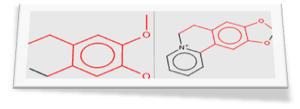
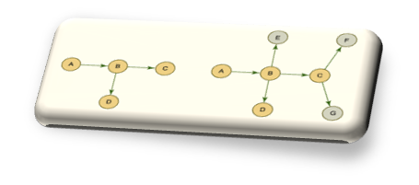
Subgraph (Homo)Isomorphism and Graph Simulation
Node label equivalence
Edge-to-edge function/relation
A
A
E
D
E
D
B
B
B
v₁
v₂
B
B
B
D
E
D
E
A
A
P
G
P
G
Capable enough?
Identical label matching, edge-to-edge function/relations
Yinghui Wu SIGMOD 2011
Notes:
Traditional graph pattern matching…
Simulation comes from automaton verification

Slide 54
Graph Homomorphism Revisited
Graph homomorphism
A graph homomorphism (resp. subgraph isomorphism) f from a graph G = (V,E) to a graph G' = (V',E'), is a mapping (resp. 1-1 mapping) from V to V' such that (u,v) in E implies (f(u),f(v)) in E’ .
The maximum common subgraph isomorphism is to find the largest subgraph of G isomorphic to a subgraph of G’.

Slide 55




















Website Matching: Real Life Application
edge-to-path
mappings
A.Home
B.Index
books
sports
digital
books
audio
categories
booksets
DVDs
CDs
textbooks
abooks
albums
G₁
arts
school
audio books
features
genres
G₂
albums
55
Graph homomorphism (subgraph isomorphism) is an overkill
Notes:
This suggests a revision or extension of graph homomorphism which support edge to path matching.

Slide 56
Outline (Graph Pattern Matching)
Extended homomorphism/isomorphism
Extended simulation
Graph Queries
Incremental Graph Pattern Matching
Conclusion

Slide 57
Extensions of Homomorphism/Isomorphism
Extensions by allowing edge-paths matching
Trees –[Sanz et.al., KDE ’08]
DAGs – [Chen et.al., VLDB ’05]
general graphs
[Cheng et.al., ICDE ’08], [Fan et.al., TODS ’08], [Zou et.al., VLDB ’09], [Fan et.al SIGMOD ’10]
Notes:
There have been work on extending graph pattern matching to edge-path matching, over patterns as trees, directed acyclic graphs and general graphs.
An approximate retrieval method is proposed for matching trees [24],
which identifies and merges regions of XML data that are similar
to a given pattern, by using an inverted index. Stack-based algorithms
are studied for matching DAGs in Chen VLDB 05, by leveraging filtering
for early pruning. Exponential-time algorithms for matching general
graphs are developed in [11], based on join operations over
graphs encoded as tables. A notion of XML schema embedding is
studied in Fan TODS 08, which is a special case of p-hom with two extra
conditions. A form of graph pattern matching is considered Zou VLDB 09
in which edges denote paths with a fixed length.

Slide 58
P-Homomorphism (Fan et.al SIGMOD ‘10)
P-homomorphism from G₁ to G₂: a total mapping from V₁ to V₂
preserves node similarity (w.r.t a similarity matrix M and threshold ξ)
map edges to nonempty paths
P-homomorphism v.s graph homomorphism
node similarity v.s label equality
edge-to-path mapping v.s edge-to-edge mapping
P-hom ?
A
B
C
A
B
A
A
A
A.home
B.index
book
E
C
books
audio
sports
digital
D
D
categories
bookset
CD
DVD
D
D
textbook
B
C
B
C
C
album
G₃
G₄
G₁
G₂
Graph homomorphism is a special case of P-homomorphism
abook
arts
school
audiobooks
features
genres
58
albums
Notes:
Path - homomorphism

Slide 59
1-1 P-Homomorphism (Fan et.al SIGMOD ‘10)
G₁ is 1-1 P-homomorphism to G₂ if there exists a 1-1 (injective) P-homomorphism from G₁ to G₂.
distinct nodes have distinct matches
1-1 P-homomorphism v.s subgraph isomorphism
node similarity v.s label equality
1-1 edge-to-path mapping v.s bijective edge-to-edge mapping
1-1 P-hom ?
A.home
B.index
A
A
A
A
A
book
sports
digital
books
audio
C
B
B
D
v₁
v₂
categories
bookset
CD
DVD
album
B
textbook
D
B
E
C
B
C
C
arts
D
E
abook
G₅
school
audiobooks
features
genres
G₁
G₂
G₆
albums
59
Subgraph isomorphism is a special case of 1-1 P-homomorphism

Slide 60
Measuring Graph Similarity (Fan et.al SIGMOD ‘10)
Maximum cardinality:
Card(ρ) = |V₁’|/|V|
Maximum cardinality problem CPH (resp. CPH¹⁻¹): find P-hom (resp. 1-1 P-hom) ρ having the maximum Card(ρ).
Maximum Common Subgraph(MCS) is a special case of CPH¹⁻¹
Overall similarity:
Sim(ρ) = ∑(w(v) * M(v, ρ(v)) / ∑w(v)
Maximum overall similarity SPH (resp. CPH¹⁻¹): find P-hom (resp. 1-1 P-hom) ρ having the maximum Sim(ρ) .
Not every node in one graph can find P-hom matches in the other graph …

Slide 61
Complexity Results
Intractability
P-Hom and 1-1 P-Hom are NP-complete.
CPH, CPH¹⁻¹, SPH, SPH¹⁻¹ are NP-hard.
Approximation hardness
Unless P=NP, CPH, CPH¹⁻¹, SPH, SPH¹⁻¹ are not approximable within O(1/n^{1-ε}) for any constant ε, with n the node number of input graphs.
approximation factor preserving reduction (AFP-reduction) (from maximum weighted independent set problem)
Approximation bound?
O(log² (|V₁||V₂|)/ (|V₁||V₂|))
P-Hom can be solved with a provable performance guarantee
Notes:
All the effort on extending subgraph isomorphism end up with intractable results.
So now comes the question.
Can we formulate a pattern matching which preserves structural/topological information and node semantics,
while strike a balance between the expressive power and the complexity, and are even more practical than
Subgraph isomorphism?

Slide 62
Outline (Graph Pattern Matching)
Extended homomorphism/isomorphism
Extended simulation
Graph Queries
Incremental Graph Pattern Matching
Conclusion

Slide 63



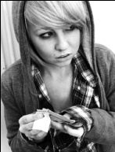

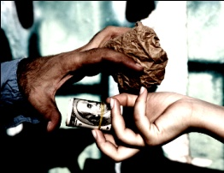
Pattern Matching in Social Graphs
Find all matches of a pattern in a graph
Identify suspects
in a drug ring
B
B
A₁
A_{m}
1
AM
S
W
W
W
3
3
W
W
W
FW
pattern graph
W
W
63
“Understanding the structure of drug trafficking organizations”
Notes:
function-based matching may still be restrictive especially in searching organizations and groups;
Identical labelling or similarity labelling could be restrictive;
In a nutshell, the pattern matching is to identify all the matches – these matches may not necessarily be isomorphic to the pattern! Also as illustrated by the previous slides.

Slide 64



Pattern Matching in Social Graphs
not allowed by bijection
relation instead of function
B
A₁
B
A_{m}
1
AM
W
W
W
S
3
3
W
W
W
FW
edges to paths
W
W
The quest for a new form of graph pattern matching

Slide 65





Bounded Simulation (Fan et.al VLDB ’10)
for each (u,v)∈ S,
attributes f_{A}(v) satisfies predicate f_{v}(u)
each (u,u’ ) in E_{Q} is mapped to a path from v to v’ of length f_{e}(u,u’ ) in G, (u’,v’ )∈ S
for each u∈ V_{Q}, there exists v∈ V such that (u,v)∈ S
G = (V, E, f_{A}) matches Q = (V_{Q}, E_{Q}, f_{v}, f_{e}) via bounded simulation, if there exists a binary relation S ⊆ V_{Q} × V such that S
is a total mapping,
satisfies search conditions and bounds on edge-to-path mappings
For any graph G and pattern P, there is a unique maximum match in G for P.
relation instead of function
B
A₁
B
A_{m}
1
AM
S
W
W
W
3
3
W
W
W
FW
edges to paths
W
W
Mapping edges to bounded paths

Slide 66
Computing Bounded Simulation
The graph pattern matching problem (in terms of extended simulation): given any data graph G and pattern graph P, find the maximum match in G for P.
The graph pattern matching problem can be solved in cubic time.

Slide 67
Complexity
Input: Pattern Q and data graph G
Output: M(Q, G)
cubic time
O(| V | | E | + | E_{Q}| | V |² + | V_{Q}| | V |)
comparable: Q is small in practice
Subgraph isomorphism: intractable
Graph simulation: O((| V_{G} | + | V_{Q} |) (| E_{G} | + | E_{Q}| )
To identify sensible matches and be computable in low PTIME
67
Notes:
This work formulate graph pattern matching with bounded simulation that is solvable in PTIME, which strikes a balance in
Expressive power and computational complexity.
Note that the notion bounded simulation maps edges to any path, but not necessarily simple path. Otherwise the problem easily becomes intractable.

Slide 68





Querying Essembly Network: an Example
fa+
strangers-nemeses
Biologists supporting cloning
strangers-allies
fa^{<=2} sa^{<=2}
friends-allies
fa^{<=2} sn
friends-nemeses
fn
…
Alice
Doctors against cloning
fn
Pattern
Essembly Network
68
Pattern queries with multiple edge types
Notes:
Regular expression: difference – high complexity

Slide 69
Graph Reachability and Pattern Queries (Fan et.al ICDE ’10)
Real life graphs usually bear different edge types…
data graph G = (V, E, f_{A} , f_{C})
Reachability query (RQ) : (u₁, u₂, f_{u1}, f_{u2}, f_{e}) where f_{e} is a subclass of regular expression of:
F ::= c | c^{≤k} | c⁺ | FF
Q_{r}(G): set of node pairs (v₁, v₂) that there is a nonempty path from v₁ to v₂ , and the edge colors on the path match the pattern specified by f_{e}.
Job=‘biologist’, sp=‘cloning’
fa^{<=2} fn
Job=‘doctors’
69

Slide 70

Graph Pattern Queries (Fan et.al ICDE ’10)
graph pattern queries PQ Q_{p} =(V_{p}, E_{p}, f_{v} , f_{e}) where for each edge e=(u,u’), Q_{e}=(u₁, u₂, f_{v}(u) , f_{v}(u’), f_{e}(e)) is an RQ.
The match Qp(G) is the maximum set (e, S_{e})
PQ vs. simulation
search conditions
edge-path relations
constrain the edges on the
path with a regular expression
for any e₁(u₁,u₂) and e₂(u₂ ,u₃), if (v₁,v₂) is in S_{e1}, then there is a v₃ that (v₂,v₃) is in S_{e2}
for any two edges e1(u1,u2) and e2(u1 ,u3), if (v1,v2) is in Se1, then there is a v3 that (v1,v3) is in Se2
RQ and simulation are special cases of PQ
fa+
fa<=2 sa<=2
Job=‘biologist’,
sp=‘cloning’
fa<=2 sn
fn
70
Id=‘Alice’
Job=‘doctors’
dsp=‘cloning’
fn

Slide 71


Reachability and Graph Pattern Query: Examples
fa+
Job=‘biologist’, sp=‘cloning’
sn
fa<=2 sa<=2
Job=‘biologist’, sp=‘cloning’
sa
fa<=2 sn
fa
fa^{<=2} fn
fn
fn
Id=‘Alice’
Job=‘doctors’
dsp=‘cloning’
fn
Job=‘doctors’
fa fa fa
fa sa
fa sn
fa fn
fn
fn
fa fa fn
fa fn
fn
fa sn
fa fa fn
fn

Slide 72
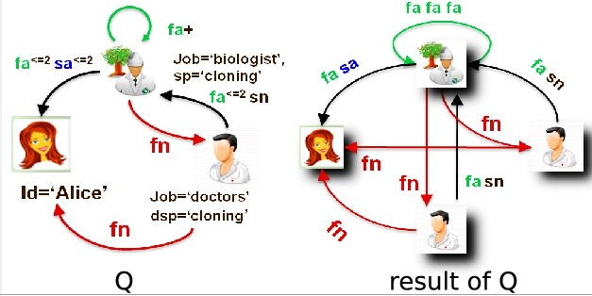
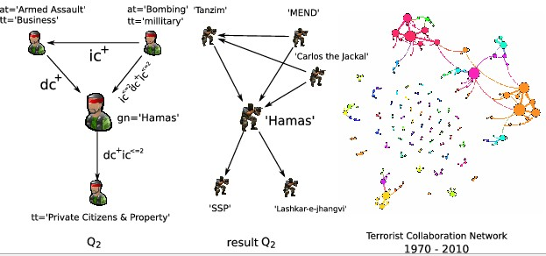
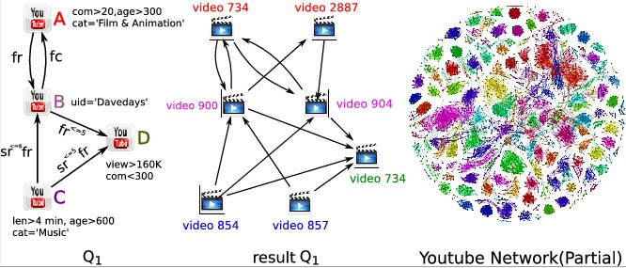
Querying Result: Examples
PQ can be answered in cubic time.
Querying Terrorist network
Querying Youtube network
72

Slide 73
Evaluating Graph Pattern Queries
PQ can be answered in cubic time.
Join-based Algorithm
Matrix index vs distance cache
Join operation for each edge in PQ
Split-based Algorithm
blocks
partition-relation pair

Slide 74
Outline (Graph Pattern Matching)
Extended homomorphism/isomorphism
Extended simulation
Graph Queries
Incremental Graph Pattern Matching
Conclusion

Slide 75



Batch Algorithm vs. Dynamic Algorithm
Graph querying is expensive!
NP-complete for subgraph isomorphism
cubic-time for bounded simulation
quadratic-time for simulation
Dynamic graph querying
How to measure complexity?
5%/week in Web graphs
P
G
M(P,G)
∆G
∆M
P
G⊕∆G
M(P,G)⊕∆M
75
Computes new matches from old matches!

Slide 76















Complexity of Dynamic Graph Querying (Fan et.al SIGMOD ’11)
Result graphs
A graph Gr = (Vr, Er) for (bounded) simulation
Vr : the nodes in G matching query nodes in Gp
Er: the paths in G matching edges in Gp
Affected Area (AFF)
the difference between Gr and Gr’, the result graph of Gp in G and G⊕∆G, respectively.
|CHANGED| = |∆G| + |AFF|
Optimal, bounded and unbounded problem
expressible by f(|CHANGED|)?
*
Ann, CTO
1
(bounded) simulation
edge-path relation
Ann, CTO
Dan, DB
subgraph isomorphism
2
1
Bill, Bio
O(|CHANGED|)
O(f(|CHANGED|))
O(f(|CHANGED|, Par))
P
P
Pat, DB
Pat, DB
Bill, Bio
Mat, Bio
76
Measure the complexity with the size of changes

Slide 77
Complexity of Dynamic Algorithms (cont) (Fan et.al SIGMOD ’11)
Insert e2
Insert e1
Ann, CTO
Dan, DB
Mat, Bio
e5
Insert e3
e3
Bill, Bio
Tom, Bio
e4
Insert e4
e2
Insert e5
Pat, DB
Don, CTO
Ross, Med
e1
∆G
G
affected area
P
Gr
Ann, CTO
Don, CTO
*
CTO
2
1
Pat, DB
Dan, DB
DB
1
Bio
Bill, Bio
Tom, Bio
Mat, Bio
77

Slide 78
Dynamic Querying via Simulation (Fan et.al SIGMOD ’11)
Problem statement
Input: Gp, G, Gr, ∆G
Output: ∆Gr, the updates to Gr s.t. Msim(G⊕∆G) = M(Gp,G)⊕∆M
Complexity
unbounded even for unit updates and general queries
bounded for single-edge deletions and general queries
optimal for single-edge insertions and DAG queries, within optimal time O(|AFF|)
In O(|∆G|(|Gp||AFF| + |AFF|²)) for batch updates and general queries
Measure the complexity with the size of changes
78

Slide 79
Dynamic Querying via Simulation: Optimal Cases (Fan et.al SIGMOD ’11)
Unit deletions and general queries
delete e6
Ann, CTO
Dan, DB
1. identify affected edges
Mat, Bio
2. find invalid match
Bill, Bio
e6
3. propagate affected
area and refine matches
Pat, DB
Don, CTO
G
P
Gr
Ann, CTO
affected area / ∆Gr
CTO
Pat, DB
Dan, DB
DB
e6
79
optimal with the size of changes
Bio
Bill, Bio
Mat, Bio
Yinghui Wu SIGMOD 2011

Slide 80
Dynamic Querying via Bounded Simulation (Fan et.al SIGMOD ’11)
Unit updates
Only the node pairs with at least a match and updated distances satisfying (resp. not satisfying) the bound of a query edge may affect the matching result
A two-step strategy
Identify all affected node pairs (via a landmark vector)
find changes ∆M to matches, by treating affected node pairs as insertions of the edges to Gr (deletions from Gr)
“reducing” bounded simulation in G to simulation in Gr
80

Slide 81
Dynamic Querying via Bounded Simulation (Fan et.al SIGMOD ’11)
unit insertion and general queries
Step 1: identify node pairs with changed distance
P
*
CTO
…
2
Ann, CTO
Step 2: find the changes to match by inserting edge (Don, Tom) in Gr and propagating changes
1
…
DB
1
Pat, DB
Bio
e2
Don, CTO
Gr
Ann, CTO
Don, CTO
Gr
Tom, Bio
Pat, DB
Dan, DB
…
Dan, DB
Ann, CTO
Mat, Bio
Bill, Bio
Tom, Bio
Mat, Bio
Pat, DB
81
unit deletion is similarly processed as unit insertion

Slide 82
Complexity Result
Measuring complexity with the size of changes
Problem | Complexity | Solution
IncSim | Unbounded, Bounded for unit deletion/ unit insertion and DAG queries | O(|∆G|(|Q||AFF| + |AFF|²))
IncBSim | Unbounded | O(|∆G|(|Q||AFF| + |AFF|²)) time
82

Slide 83
Outline (Graph Pattern Matching)
Extended homomorphism/isomorphism
Extended simulation
Graph Queries
Incremental Graph Pattern Matching
Conclusion

Slide 84
Take away messages
Traditional homomorphism and simulation are too restrictive for real life graph pattern matching
Extended subgraph homomorphism/isomorphism: (1-1) P-homomorphism, edge to path matching, provable guarantees on match quality.
Extended simulation: bounded simulation, bounded connectivity, PTIME
Adding regular expressions to query edges: reachability/graph queries
Incremental bounded simulation, solvable in time bounded by the affected area and the size of the query.

Slide 85
Graph Pattern Matching
Graph Pattern Matching
Subgraph hom/isomorphism/edit distance
P-hom/1-1 P-hom[Fan et.al., VLDB ’08]
graph simulation
regular queries
bounded simulation[Fan et.al., VLDB ’10]
query languages
graph pattern queries[Fan et.al., ICDE ’11]
approximate queries/heuristic matching
incremental pattern matching[Fan et.al., SIGMOD ’11]
Feature based approaches
Vertex similarity

Slide 86
Presentation Sketch
KEYWORD SEARCH
GRAPH SEARCH
GRAPH PATTERN MATCHING
GRAPH PATTERN MINING
CONCLUSION

Slide 87
What are Graph Patterns?
Given a graph dataset D, find all subgraphs g, s.t.
freq(g) ≥ θ
Where freq(g) is the number of graphs that contain g.
c
c
a
b
e
a
a
b
c
e
d
d
a
b
d
f
f
f
d
G₁
G₂
G₃
G₄
a
b
c
a
b
b
c
c
Θ=3
a
b
d
a
b
b
d
d
c
b
d

Slide 88
Why Mine Graph Patterns?
Direct Use:
Mining over-represented sub-structures in chemical databases.
Mining conserved sub-networks.
Program control flow analysis.
Indirect Uses:
Index the data graph and query graph using local features.
Building block of further analysis, i.e., Classification, Clustering, Similarity Searches, Indexing

Slide 89
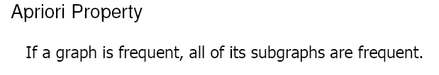
Why is Graph Mining Hard?
The search space is huge.
A graph with e edges has 2e subgraphs.
Exponential search space + graph isomorphism + subgraph isomorphism.
a
b
c
a
a
a
b
a
c
b
b
b
c
c
c
a
a
a
a
b
a
b
a
b
a
c
a
b
b
b
b
c
b
a
a
b
a
b
b
c
a
b
a
c
b
b
b
c
b
c
c
a
a
c
a
b
c
b
a
c
a
c
c
b
c
a
c
c
c
Pattern Search Tree

Slide 90
Pattern Mining in Graph Database
A. Candidate Generation:
- join two graphs from the previous
level of the search tree that share a
common core.
- BFS traversal of search tree.
Remove Duplicates:
remove duplicate candidates by efficient canonical form and graph isomorphism testing.
C. Frequency Counting:
- prune if the intersection of the occurrences of its sub-patterns has lower than threshold frequency (more memory for BFS traversal).
- otherwise do subgraph isomorphism to count exact frequency.
AGM (vertex based candidate generation). Inokuchi et al., PKDD ’00
FGS (edge based candidate generation). Kuramochi et al., ICDM ’01
Path-Join (edge disjoint path based candidate generation). Vanetik et al., ICDM ’02
Apriori Approach
Pattern Growth
Approach

Slide 91
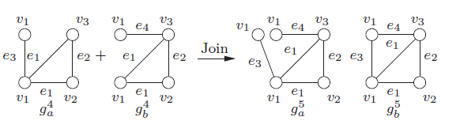
FGS [Kuramochi et. al., ICDM ’01]
Apriori Based Approach with Candidate Set Generation.
Find all frequent subgraphs of size K.
Generate candidates of size K+1 edges by joining candidates of size k edges.
Must share a common subgraph of K-1 edges.

Slide 92
FGS [Kuramochi et. al., ICDM ’01]
Check if the K+1 edge graph already in the candidate set. (Graph Automorphism).
Check if all its K edge subgraphs are in the frequent set.
Insert the K+1 edge graph into candidate set.
Count the frequency of each element in the candidate set whether it is frequent. (Subgraph Isomorphism).

Slide 93
Pattern Mining in Graph Database
A. Grow Pattern:
extend existing subgraph by an edge and/or a node. The extension must be chosen carefully to reduce duplicates.
- DFS traversal of search tree.
Remove Duplicates:
remove duplicate candidates by efficient canonical form and graph isomorphism testing.
C. Frequency Counting:
- prune if the intersection of the occurrences of its sub-patterns has lower than threshold frequency (less memory for DFS traversal).
- otherwise do subgraph isomorphism to count exact frequency.
Problems:
Many candidates are generated at higher depth of search tree. Removal of duplicates expensive.
More memory due to BFS traversal of search tree.
Apriori Approach
Pattern Growth
Approach
gSpan . Yan et al., ICDM ’02
MoFa. Borgelt et al., ICDM ’02
FFSM. Huan et al., ICDM ’03
SPIN. Huan et al., KDD ’04
5) GASTON. Nijssen et al., KDD ’04

Slide 94
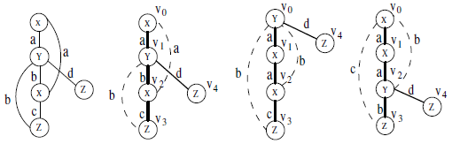
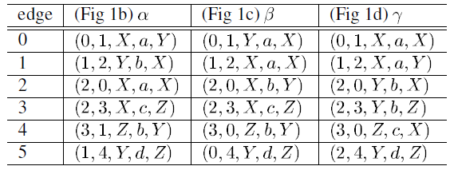
gSpan [Yan et. al., ICDM ’02]
Pattern Growth Approach without Candidate Set Generation.
DFS Coding to translate a graph into a sequence of edges, generated by performing a Depth First Search.
Two graphs are isomorphic iff their minimum DFS codes are the same.
DFS Code

Slide 95
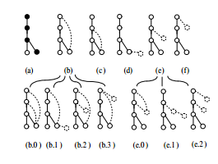
gSpan [Yan et. al., ICDM ’02]
Sort all frequent 1-edge graphs into a list S based on their DFS lexicographical order.
For each graph in S, add one new edge to construct all its children. The new edge can be added only at nodes that lie on the rightmost path of the DFS-tree.
If some children does not represent the minimum DFS code or it is infrequent, then the child is pruned. (graph Automorphism)
Growth of DFS Tree

Slide 96
Variations of Graph Pattern Mining
Mining Closed Frequent Graph Patterns [CloseGraph, Yan et. al., KDD ‘03].
Constraint Based Graph Pattern Mining [gPrune, Zhu et. al., PAKDD ‘07].
Significant Graph Pattern Mining [LEAP Search, Yan et. al., SIGMOD ‘07].
In Single Graph: Given a large graph G, find all subgraphs g, s.t. freq(g) ≥ θ, Where freq(g) is the “frequency of occurrences” of g in G.
c
freq(g) = 6 ?
freq(g) = 2 ?
freq(g) = 1 ?
Downward Closure ??
b
b
a
c
b
a
b
c
Graph Pattern
Input Graph

Slide 97
Pattern Mining in Single Large Graph
Exact Sub Graph Structure Based:
Kuramochi et. al., SDM ’04.
Fiedler et. al., MLG ’07.
Nijssen et. al., PAKDD ‘08.
Correlation between Graph Structures and Label Occurrence:
Guan et. al., SIGMOD ’11.
Silva et. al., PVLDB ’12.
Proximity Based:
Khan et. al, SIGMOD ‘10.

Slide 98
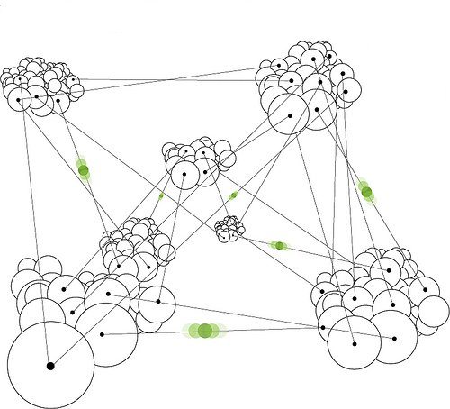
Motivation (Proximity Pattern) [Khan et. al., SIGMOD ‘10]
Last.FM
Nodes -> Users
Edges -> Links
List of Musical
Bands/ Singers
Lady Gaga
Beyonce,
Madonna
Katy Perry,
Madonna
Britney
Spears,
Lady Gaga
Britney
Spears
What are the related Musical Bands/ Singers
that co-occur frequently in neighborhood?
Metallica
Metallica,
Megadeth
Megadeth,
Slayer
Megadeth,
Slayer
Homophily in Social Network

Slide 99
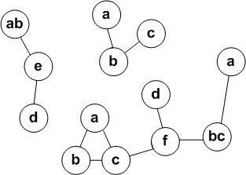
Proximity Pattern Definition
Proximity
Frequency
a, b – YES
a, b, c – YES
d, e, f - NO

Slide 100
Proximity Pattern Definition
Will Frequent Subgraph Mining Work? - NO !!!
Flexibility
Will Frequent Itemset Mining Work? - NO !!!
No Notion of Edge in Frequent Itemset Mining.
{a, b, c}
Frequent Subgraph – No
Frequent Itemset - No
Proximity Pattern - Yes

Slide 101
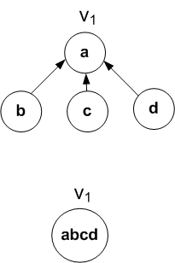
Information Propagation Model
Influence Based Information Propagation.
Labels are propagated with certain probability from each node to its neighbors.
Labels are propagated independent to each other.
Information Propagation

Slide 102
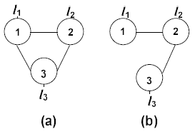
Information Propagation Model
Downward Closure.
Consistent with graph structure.
Table (a)
 | l₁ | l₂ | l₃
node₁ | 1 | 0.37 | 0.37
node₂ | 0.37 | 1 | 0.37
node₃ | 0.37 | 0.37 | 1
Sup(l₁, l₂, l₃) = 0.14
Table (b)
 | l₁ | l₂ | l₃
node₁ | 1 | 0.37 | 0.14
node₂ | 0.37 | 1 | 0.37
node₃ | 0.14 | 0.37 | 1
Sup(l₁, l₂, l₃) = 0.08
Notes:
Product set based transaction-rule association process

Slide 103
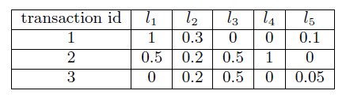
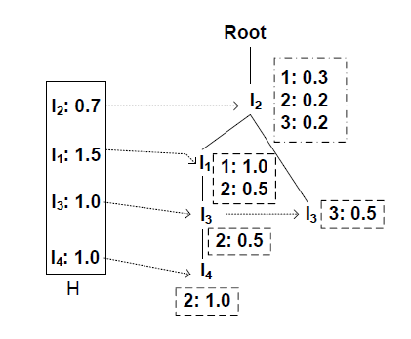
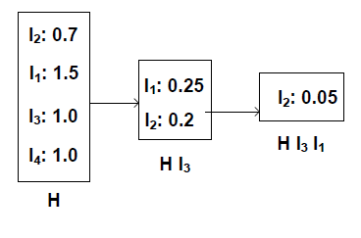
Probabilistic Itemset Mining
Probabilistic FP-Growth (pFP):
associating a bucket with each node of the FP-tree.
Notes:
Traverse through T to generate rule set R
Find the rules in R that are associated with γ
Compute the mutual promotion value for each associated rule
Each rule’s contribution value is computed based on its mutual promotion value
Aggregate all rules’ contribution values as the promotion value of γ

Slide 104
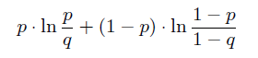
Top-k Interesting Pattern Mining
How to measure “Interesting-ness”? – Randomization Test.
Generate graph Q from graph G by randomly swapping the labels among nodes. Let, p and q be the support values of itemset I in G and Q respectively. High difference indicates interestingness.
G-test Score:
Vertical Pruning by Yan et. al (SIGMOD ‘08).
Proximity Patterns minus Frequent Patterns.
Notes:
Traverse through T to generate rule set R
Find the rules in R that are associated with γ
Compute the mutual promotion value for each associated rule
Each rule’s contribution value is computed based on its mutual promotion value
Aggregate all rules’ contribution values as the promotion value of γ

Slide 105
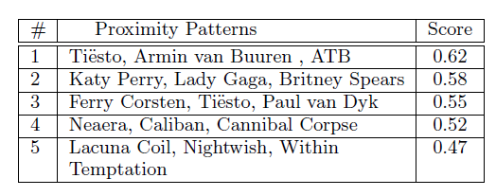
Experimental Results
EFFECTIVENESS (Last.FM):
Proximity
Patterns
ATB, Paul van Dyk – German DJ
Tiesto, Ferry Corsten, Armin van Buuren – Dutch DJ
Britney Spears, Lady Gaga, Katy Gaga – American Female Pop Singers
Neaera, Caliban, Cannibal Corpse – Death Metal Bands
Lucuna Coil, Nightwish, Within Temptation – Gothic Metal Bands
Notes:
The first row: on small scale synthetic data
For a certain n, each
method generates a set of products on promotion. We
compute the promotion value ¼ for each set. Figure 2(a)
visualizes the comparison of NPS, HTS, LSG and OS on
¼ value using Synth, where ”Naive” refers to NPS and
”Optimal” refers to OS. It is shown that the line of LSG
overlaps completely with that of OS, which proves the
effectiveness of LSG. NPS performs poorly compared to
other three methods, which is expected due to its inability to
tackle cross-selling effect. HTS fails to generate as good set
as LSG, however still outperforms NPS due to its heuristic
search process.
The second row: on large scale real-world data
Similarly, Figure 3(a)
shows the comparison of NPS and LSG on ¼ using CH
SMarket. It is shown that LSG prominently outperforms
NPS in maximizing promotion value. It is also interesting
to see that the ¼ value actually slightly decreases when n
increases. This demonstrates that promoting more products
does not necessarily imply higher promotion effect, since a
larger set of products on promotion indicates a higher probability
of cross-selling effect between promoted products.

Slide 106
Presentation Sketch
KEYWORD SEARCH
GRAPH SEARCH
GRAPH PATTERN MATCHING
GRAPH PATTERN MINING
CONCLUSION

Slide 107
Conclusion
A brief overview of various kinds of graph queries proposed in the past five years.
Technical details about graph pattern matching, graph pattern mining and similarity search in the context of emerging graph queries.
New challenges and future research directions in graph query and graph database; e.g., graph storage system, distributed query processing, dynamic load balancing, graph indexing, and other interesting graph queries; e.g., large graph alignment.

Slide 108
Questions
DC(u₄) = D(abc)-T(abc)-T(ab)-T(ac)-T(bc)-T(a)-T(b)-T(c)-1 = 3
Top-k Buffer to store top-k skyline nodes.
Thank You ! ! !
108
Notes:
INSTRUCTIONS: Standard technical results slide (2-slide version). Please keep this layout and subheadings. A template is at the end of this exemplar.
Bar-Noy, Basu, Johnson, Ramanathan, “Minimum-cost Broadcast through Varying-size Neighborcast”, Algosensors 2011, Germany, Sept 2011
Johnson, Phelan, Bar-Noy, Basu, Ramanathan, “Minimum-cost Broadcast through Varying-size Neighborcast”, Draft for submission to IEEE ToN (ToN paper has some more hardness results, simulation study and comparisons)
The problem of interest is to broadcast a message originating at a source node to all nodes in the network.
Source node and relay node can multicast to a subset of their neighbors (and they may also perform multiple multicasts to disjoint sets of neighbors). If a node multicasts to a subset k of its neighbors, the incurred cost is 1 + A k^b, where A, b are non-negative constants; `1’ represents the normalized cost of the (first) transmission, and the second term the cost of ACKs and re-transmits. The work also considers the case where the second term is either a sub-linear or a super-linear function of k. The minimum cost problem is formulated as an integer programming problem, and is NP-hard for a range of b expressed as a function of A.
The top line in the table is, in fact, a very important result: if b > g(A) := log₂( 2 + 1/A), then multicast cannot outperform unicast; thus, the spanning tree is optimal.
If b=0, problem reduces to the connected dominating set (CDS) problem for which approximability results are known; the approximation ratio is H_{Δ}+ 2
If b=1, problem reduces to minimizing number of transmitters (equivalently the maximum leaf spanning tree); a polynomial time algorithm with approximation ratio 2 is known; the paper improves the approximation ratio by using a pruned CDS approach.
For b > g(A), spanning tree is optimal
For b < g(A), the problem is shown to be NP-hard
For 1 < b < g(A), the paper shows that a spanning tree has very good approximation ratio (less than 2)
For 0 < b < 1, a greedy algorithm is proposed and its approximation ratio derived. Note that the approximation ratio improves with larger b and smaller Δ
Overall note that the approximation ratio becomes worse for smaller b
Note: the network size ‘n’ plays a part in the `inapproximability’ results
The model assumes a known cost function; but the exponent ‘b’ depends both upon the actual protocol as well as open the operating environment (e.g., congestion). Thus ‘b’ may vary and may be hard to estimate. How sensitive is the proposed algorithm when there are errors in estimating ‘b’? The figure on the right shows cost (as incurred by the proposed algorithm) vs. the actual ‘b’ of the underlying cost function; the black curve is the `optimal’ one – it uses the true value of ‘b’; the performance of the algorithm when ‘b’ is assumed to be fixed at some value is shown
Here, Δ is the maximum node degree in the graph
H_{n} = n-th Harmonic number = 1 + 1/2 + 1/3 + ¼ + … + 1/n ~= log (n) + \gamma + small constant
Where \gamma is the Euler-Mascheroni constant, approximately 0.5772

